Slide 1
A customized Vision Transformer for accurate detection and classification of Java Plum leaf disease
Arnub Datta 221-15-4726
Abu Zahed 221-15-4716
Md Amir Hamja 221-15-4784
Nurjahan Akther Mim 221-15-4782
Fatema Akter Priya 221-15-4765

Slide 2
TABLE OF CONTENTS
Abstract
Introduction
Literature Review
Research Methodology
Main Work
Results Analysis
Limitation
Future Work
Conclusion

Slide 3
ABSTRACT
This study applies Vision Transformer (ViT) models to detect Java Plum leaf diseases accurately.
ViT's self-attention mechanism captures detailed patterns for enhanced image classification.
Java Plum diseases like Bacterial Spot and Powdery Mildew significantly affect crop productivity.
The study achieves a high accuracy rate of 97.51%, highlighting ViT's potential in agricultural diagnostics.
Findings suggest ViT as a viable tool for early and accurate crop disease detection.

Slide 4
INTRODUCTION:
Java Plum is a valuable crop in Southeast Asia, but its yield and quality are heavily affected by leaf diseases.
Vision Transformers (ViTs) offer advanced image classification capabilities, making them promising for detecting plant diseases.
Timely and accurate disease detection is essential to prevent crop loss and maintain agricultural productivity.
This study aims to customize a ViT model specifically for Java Plum leaf disease detection, filling a gap in existing research and supporting precision agriculture.

Slide 5
RESEARCH GOALS
Enhance Detection Accuracy
Aim to develop a Vision Transformer (ViT) model tailored for detecting and classifying Java Plum leaf diseases with high precision.
Optimize Model Efficiency
Customize the ViT model’s hyperparameters, including image and patch sizes, to improve training efficiency and reduce computational demands.
Support Precision Agriculture
Provide a reliable and automated tool that can help farmers and agronomists detect diseases early, ensuring better crop management and reduced yield loss.

Slide 6
LITERATURE REVIEW
Author | Model | Accuracy | Contribution
De Silva et al. (2023) | ViT | Train 93.71 % & Test 90.02 % | Underscored the possibility of employing sophisticated imaging methods for precise and dependable identification of plant diseases.
Zhou et al. (2023). | Pre-trained vision transformer | 92.00% | Proposed a residual-distilled transformer architecture.
Li et al. (2023) | SLViT | Accuracy bonus of 1.87 % over MobileNetV3 | Presented a hybrid model that was initially trained on the publicly available dataset.
Sun et al. (2023) | SE-VIT | 97.26% | Using limited datasets, the SE-VIT model smartly manages sugarcane plantations and addresses plant diseases.
Thai et al. (2023) | Tiny-LeViT | 97.25% | The Tiny-LeViT model, which relies on the transformer architecture, was suggested to classify leaf diseases efficiently.

Slide 7
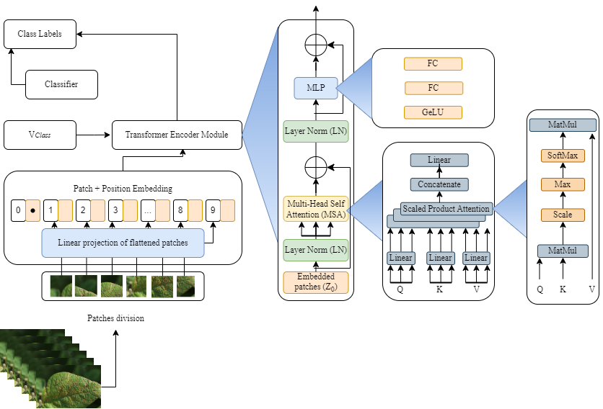
RESEARCH METHODOLOGY

Slide 8
PROPOSED ALGORITHM
1 Input: Image Data.
2 Output: Best Java Plum Leaf Detection Model (model.h5).
3 Initialize Vit models, list of image size, list of patch size, and evalList.
#Dataset preparation.
4 Load dataset (Folder inside image data).
#Model & Parameter Initialization.
5 ImageSize = [from 21 to 64].
6 PatchSize = [from 4 to 12].
#Hyperparameter Optimization.
7 For each model in ViT:
For each size in ImageSize:
For each batch in PatchSize:
Model. Train (imgsize, patch).
Append evaluation result to evalList.
#Model Evaluation & Export.
8 imgsize, patch = Get optimal hyperparameter based on highest accuracy.
9 model. Evaluate (imgsize, patch).
10 Export model weight.

Slide 9
MAIN WORKS
1. This study introduces a customized ViT model for accurately classifying Java Plum leaf diseases.
2. A primary dataset is collected to enhance the model’s scalability and real-world applicability.
3. An algorithm prunes less critical attention heads, reducing model size by 28% and improving F1 score by 2%.
4. Sparse matrix-matrix multiplication in self-attention improves training efficiency by 10% and cuts GPU usage by 15%.
5. Results show this ViT model outperforms existing models by at least 1%, confirming its robustness and accuracy.

Slide 10
RESULT ANALYSIS
Class | precision | recall | f1-score | Support |  | Class | precision | recall | f1-score | Support
Validation |  |  |  |  |  | Test
Bacterial Spot | 0.96 | 0.96 | 0.96 | 67 |  | Bacterial Spot | 0.93 | 0.97 | 0.95 | 41
Brown Blight | 0.97 | 0.94 | 0.95 | 64 |  | Brown Blight | 0.98 | 1.00 | 0.99 | 40
Dry | 0.99 | 1.00 | 0.99 | 71 |  | Dry | 1.00 | 1.00 | 1.00 | 41
Healthy | 0.92 | 0.93 | 0.92 | 58 |  | Healthy | 0.97 | 0.93 | 0.95 | 40
Powdery Mildew | 0.98 | 0.98 | 0.98 | 61 |  | Powdery Mildew | 1.00 | 0.97 | 0.99 | 40
Sooty Mold | 1.00 | 1.00 | 1.00 | 69 |  | Sooty Mold | 0.97 | 0.97 | 0.97 | 40
accuracy |  |  | 0.97 | 390 |  | accuracy |  |  | 0.98 | 241
macro avg | 0.97 | 0.97 | 0.97 | 390 |  | macro avg | 0.98 | 0.98 | 0.98 | 241
weighted avg | 0.97 | 0.97 | 0.97 | 390 |  | weighted avg | 0.98 | 0.98 | 0.98 | 241

Slide 11
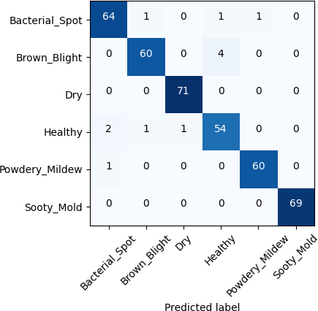
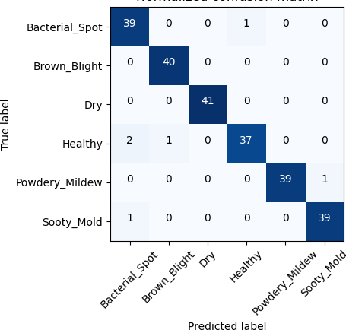
RESULT ANALYSIS Cont...

Slide 12
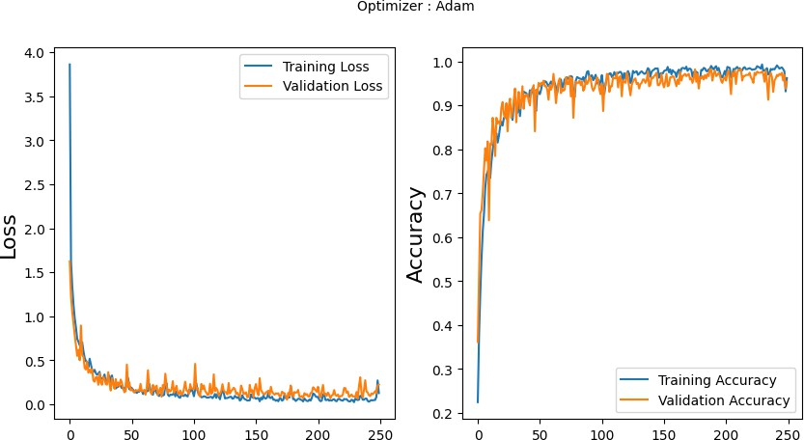
RESULT ANALYSIS Cont...

Slide 13
Limitation
Dataset Limitations
The Java Plum Leaf Disease Dataset was collected during September, October, and November 2023 in Cumilla, Bangladesh, limiting its generalizability.
Challenges in Data Collection
Obtaining a diverse and comprehensive dataset with accurately labeled instances of various diseases is a significant challenge.
Model Limitations (ViT)
The performance of the Vision Transformer (ViT) depends on factors like dataset size, model architecture, batch size, patch size, and head numbers.
Lack of Practical Implementation
The ViT model lacks practical implementation, and there's still potential for misclassification or false positives despite its accuracy.
Focus on Limited Diseases
The study only addresses a few diseases affecting Java Plum leaves and does not explore other plant diseases.

Slide 14
Future Work
Reinforcement Learning for Autonomous Detection
Hybrid Machine Learning Models
Case-Based Reasoning for Model Improvement
Addressing Data Scarcity and Environmental Variability
Real-Time Detection Challenges

Slide 15
CONCLUSION
The Vision Transformer (ViT) model demonstrated impressive accuracy (97.51%) in detecting Java Plum leaf diseases, highlighting its potential for agricultural disease detection.
The self-attention mechanism in ViT enables effective learning of patterns between infected and healthy images, making it suitable for disease classification tasks.
The Java Plum leaf disease dataset used in this study serves as a valuable resource for training other models and advancing future agricultural disease detection technologies.
Despite existing challenges, ViT presents a promising solution for detecting Java Plum leaf diseases, with potential for further refinement in future research.

Slide 16
THANK YOU!

